Slide 1

Japan
Group Assignment:
Data Science for Energy System Modelling
By Group I:
Fulham Karimu
Paburo-san
J (hehe)
Haythem Rezgui

Slide 2
Goal
Investigate a 100% renewable energy system for Japan
Shaping
Renewable Energy Pot.
Building a PyPSA Model
Investigation
Conclusion
Split the country in regions to simplify the simulation process
Study the renewable energy potential while taking into consideration the land’s limitations
It is a long established fact that a reader will be distracted by the readable content of a page when looking at its layout.
It is a long established fact that a reader will be distracted by the readable content of a page when looking at its layout.
It is a long established fact that a reader will be distracted by the readable content of a page when looking at its layout.

Slide 3
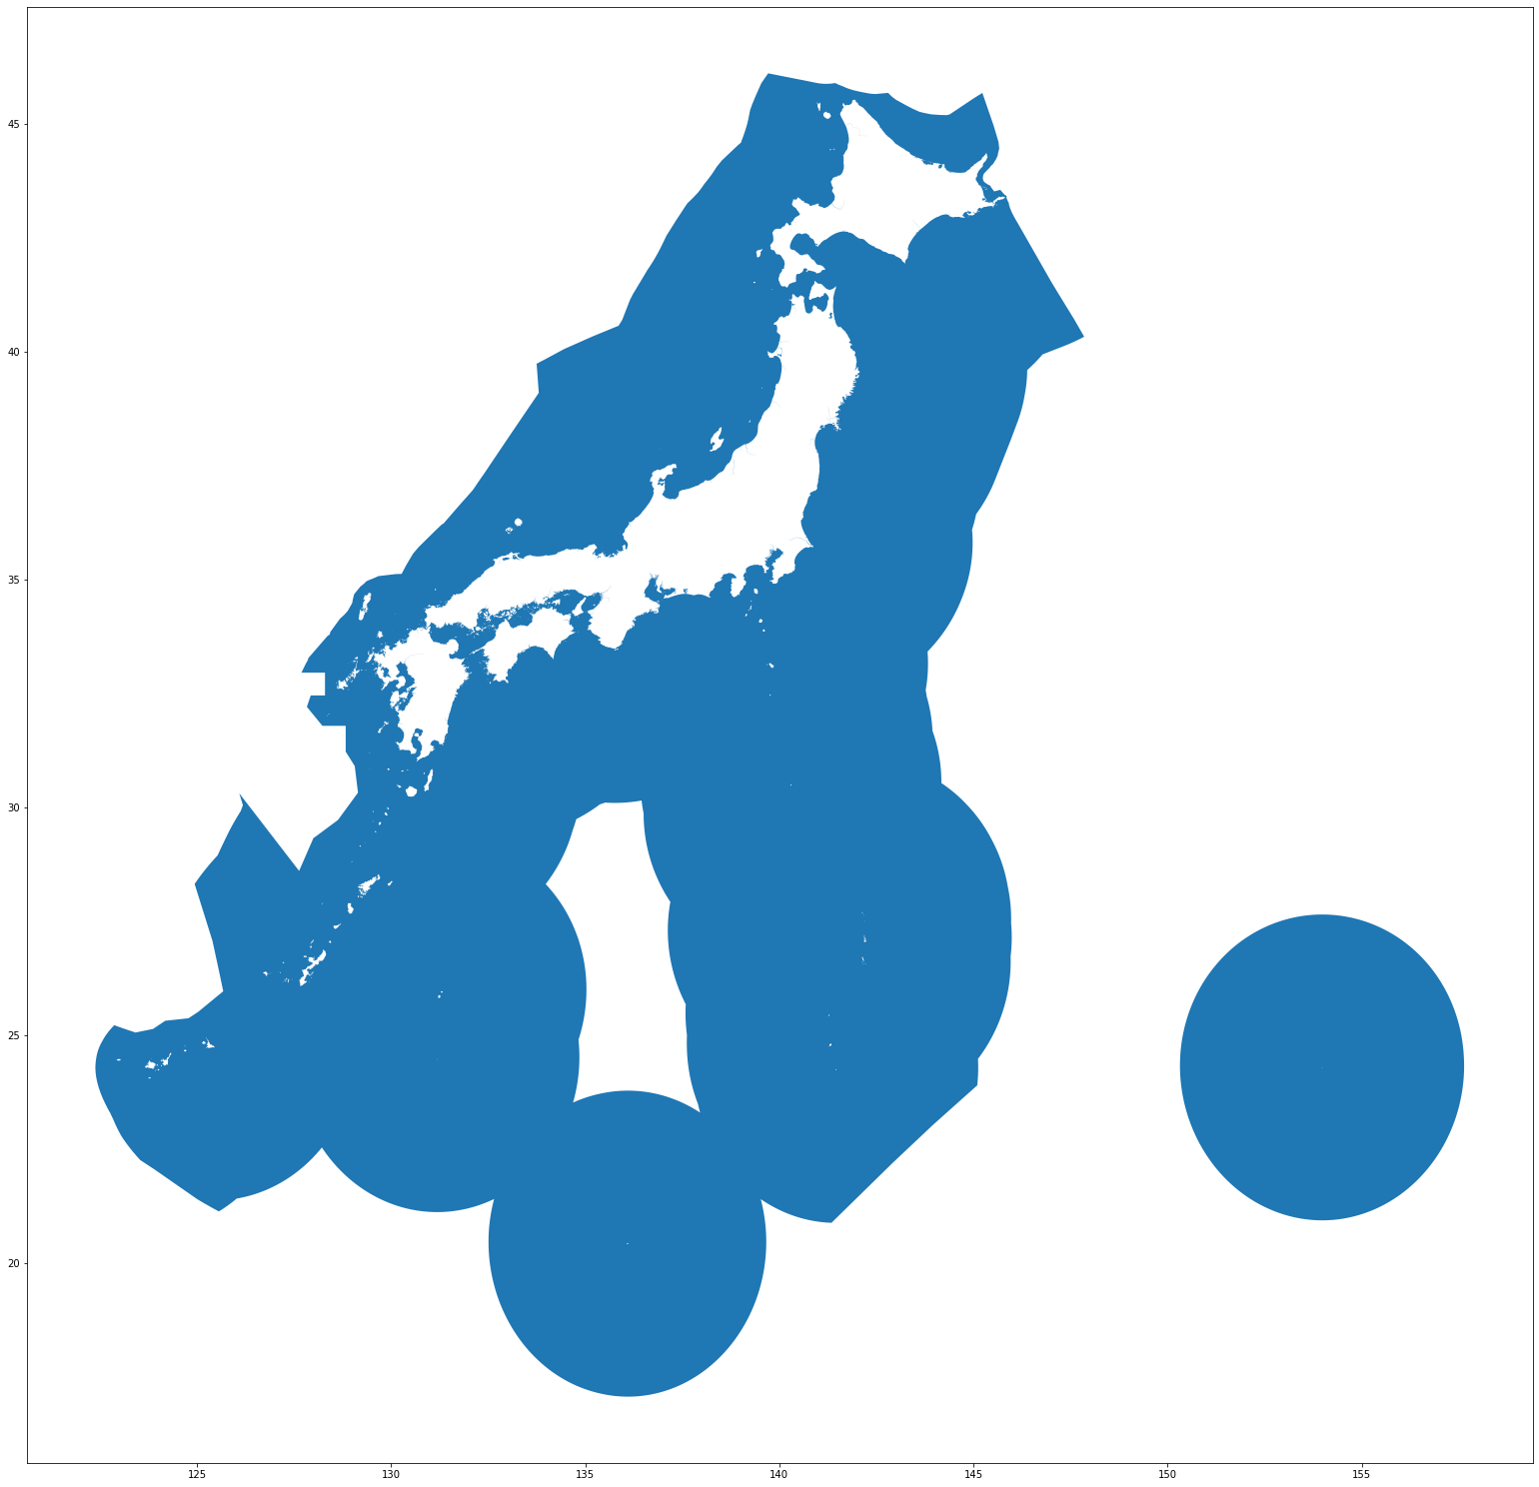
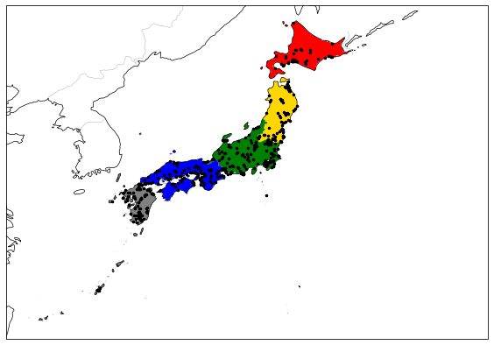
Shaping
Split the country into 5 regions as the figure shows
Powerplants are highlighted with the black markers
Used ISO codes to group the prefectures together
Build the excluders* for each of the regions
Offshore wind analysis was an exception:
EEZ zone had to be excluded from the mainland
A turn around due to the complexity of a straightforward
implementation
*: Excluded areas are shown in additional slides

Slide 4
Renewable Energy Potential
I
It is a long established fact that a reader will be distracted by the readable content of a page when looking at its layout.
II
It is a long established fact that a reader will be distracted by the readable content of a page when looking at its layout.
III
It is a long established fact that a reader will be distracted by the readable content of a page when looking at its layout.
IV
It is a long established fact that a reader will be distracted by the readable content of a page when looking at its layout.

Slide 5
PyPSA
It is a long established fact that a reader will be distracted by the readable content of a page when looking at its layout.
20%
35%
It is a long established fact that a reader will be distracted by the readable content of a page when looking at its layout.
45%
It is a long established fact that a reader will be distracted by the readable content of a page when looking at its layout.

Slide 6
Investigation
I
It is a long established fact that a reader will be distracted by the readable content of a page when looking at its layout.
II
It is a long established fact that a reader will be distracted by the readable content of a page when looking at its layout.
III
It is a long established fact that a reader will be distracted by the readable content of a page when looking at its layout.
IV
It is a long established fact that a reader will be distracted by the readable content of a page when looking at its layout.

Slide 7
Thank you for your Attention

Slide 8
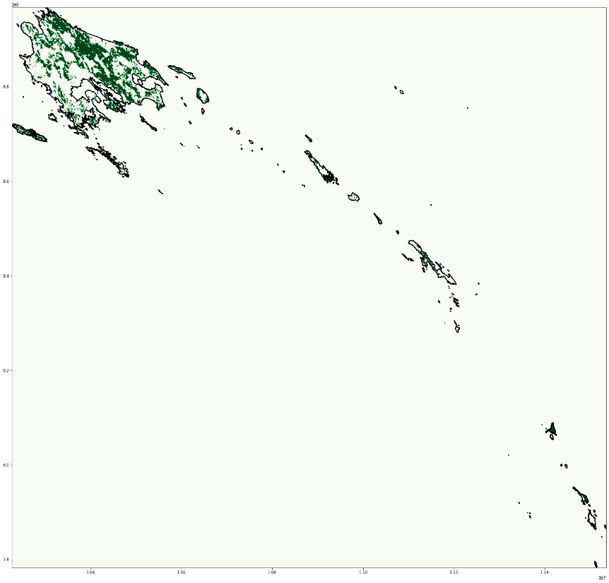
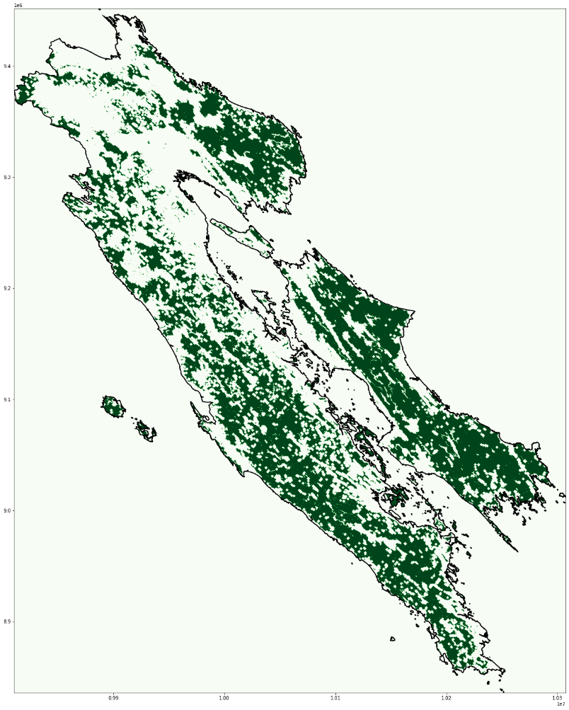
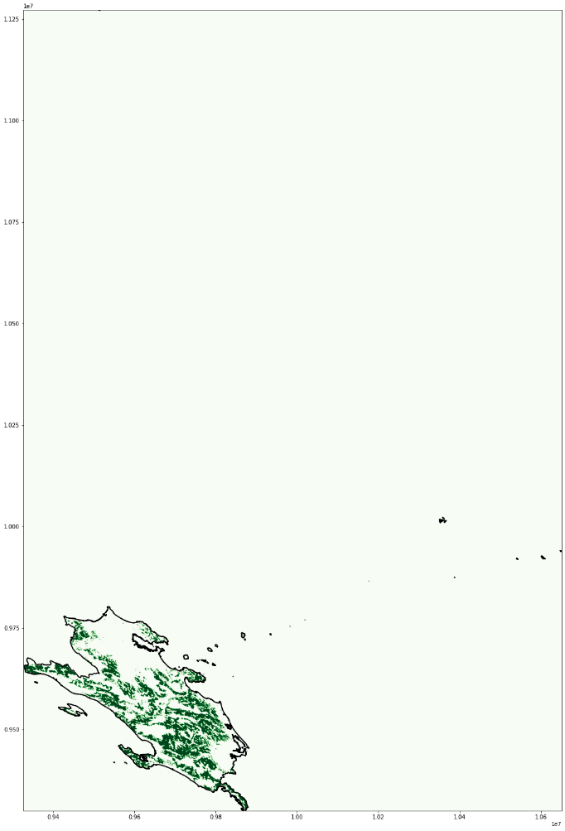
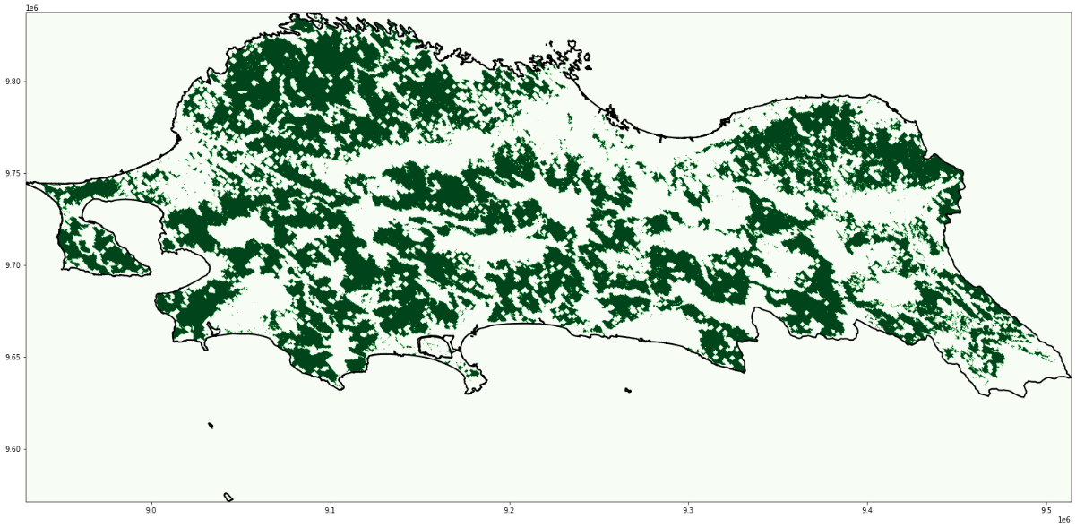
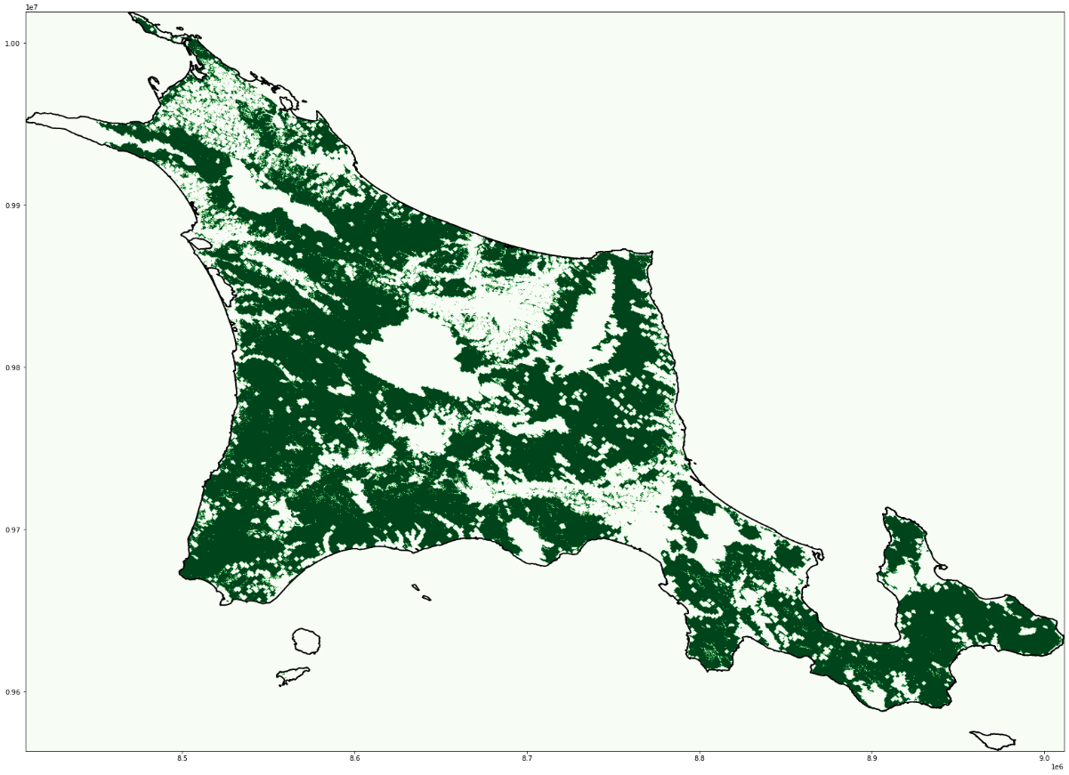
Additional Slides
→ Eligible areas for onshore wind power generation:

Slide 9
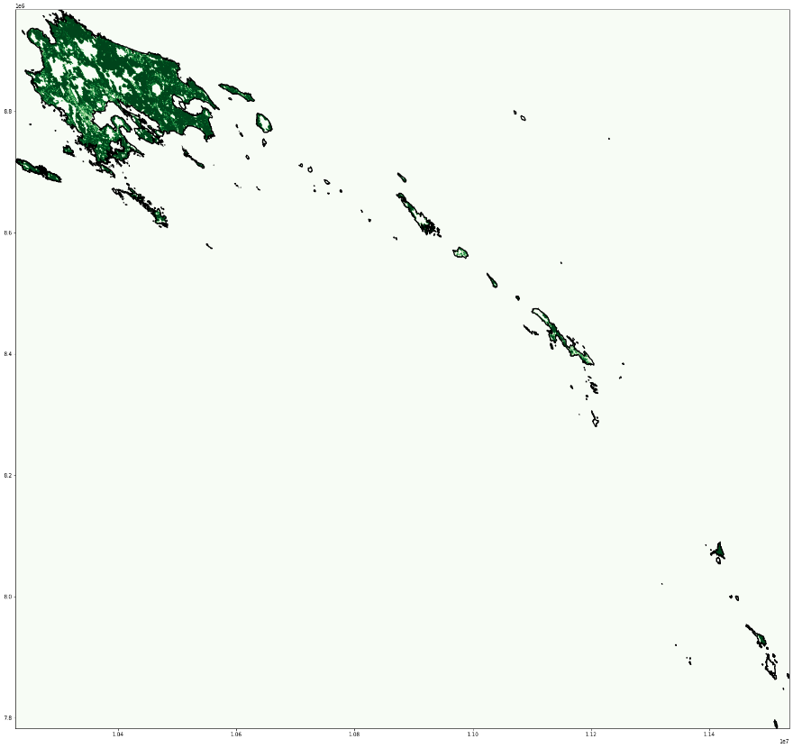
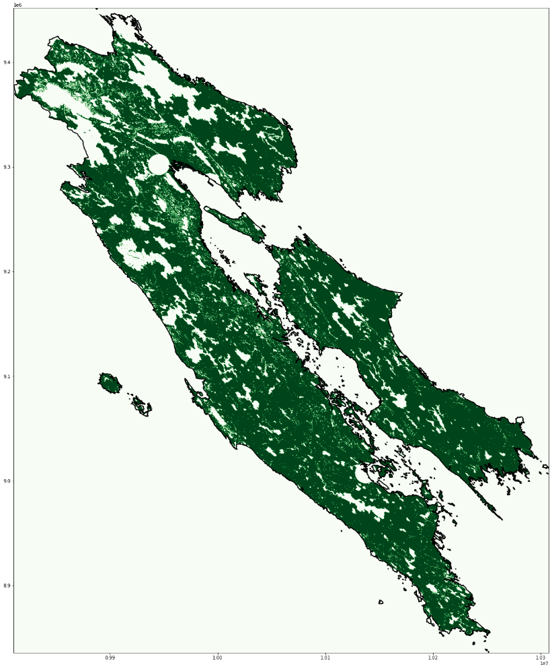
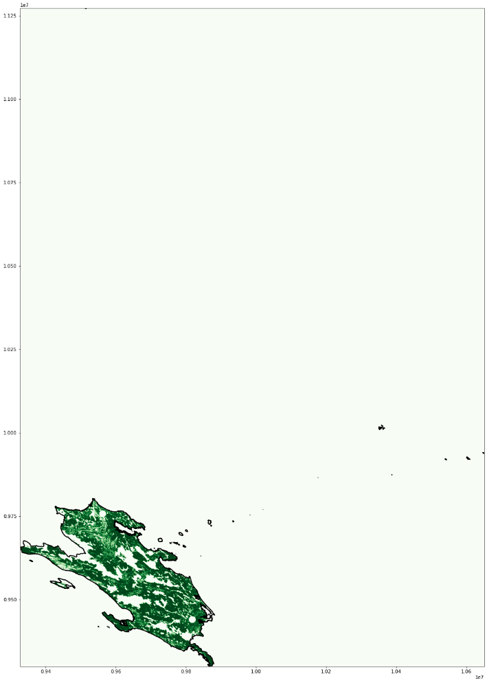
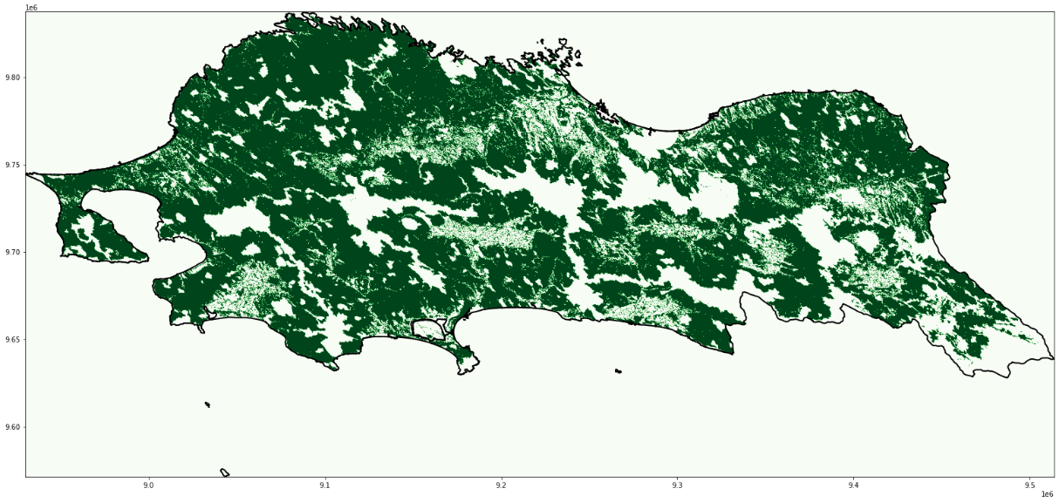
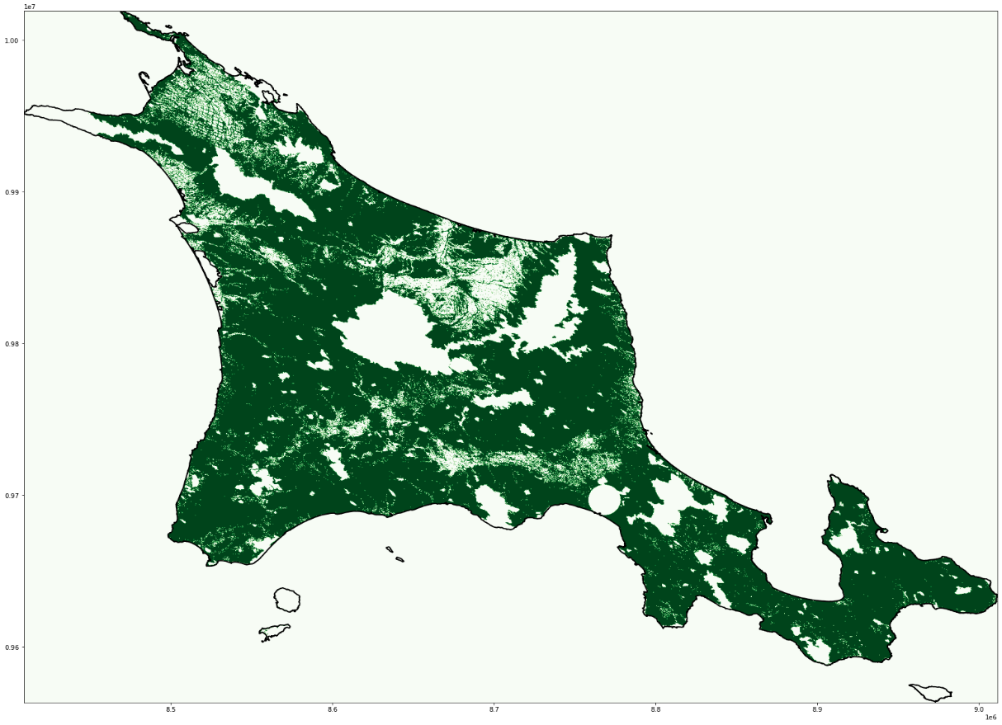
Additional Slides
→ Eligible areas for solar power generation:

Slide 10
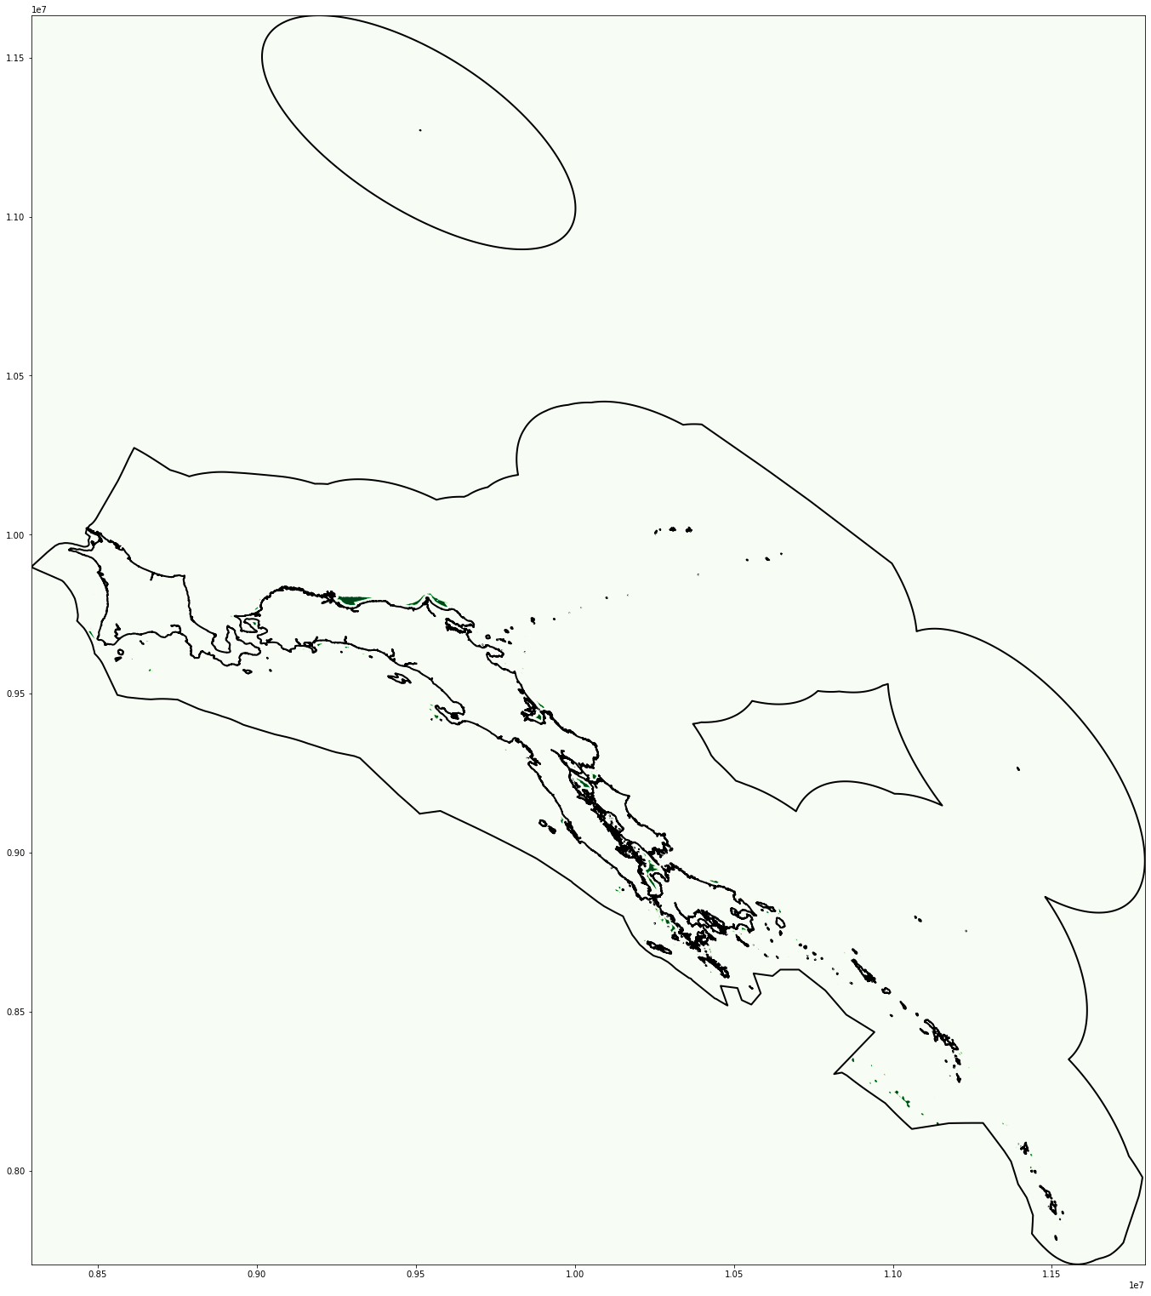
Additional Slides
→ Eligible areas for Offshore wind power generation:

